Slide 1


Rockbuster Stealth LLC
Global Data Analysis for Launch Strategy of New Online Video Streaming Services

Slide 2

Introduction
Project Overview - Rockbuster Stealth LLC is responding to significant changes in the Movie Rental business by launching an online video rental and streaming service.
Goals & Objectives - Analyze data to identify historical trends and insights to present to key Rockbuster Stealth executives and stakeholders to inform and guide the new streaming launch strategy.
Data Set - Rockbuster Stealth data file containing information about Rockbuster’s customers, film inventory, payments and rental history.
Insights - Thorough analysis of the Rockbuster Data Set yielded significant data driven trends and insights that will be very helpful in guiding the new streaming launch strategy.

Slide 3
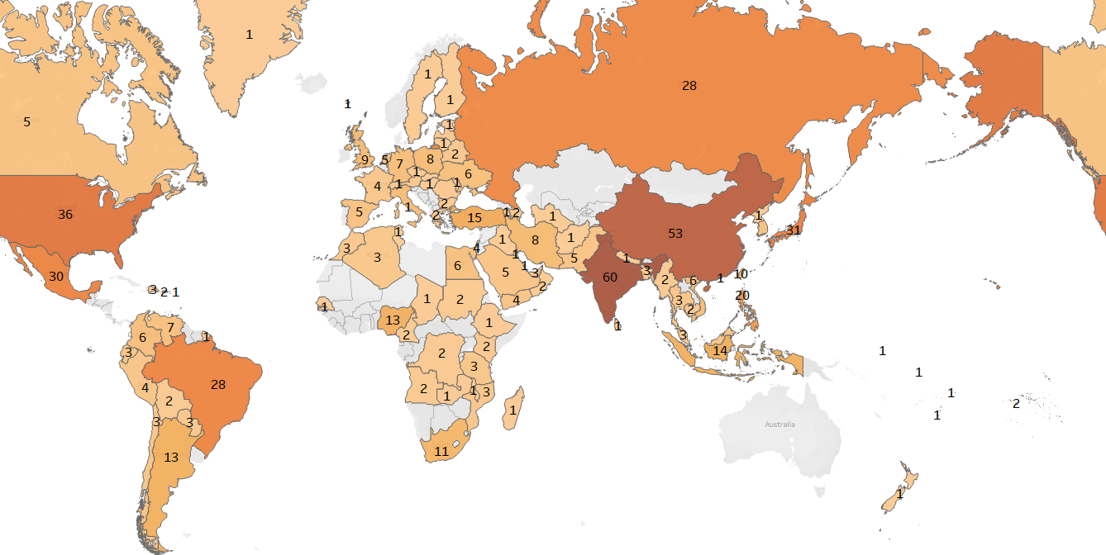
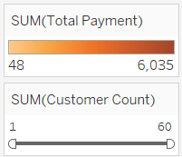
Top 10 Global Markets
Ranking | Country | Market Share
1 | India | 10%
2 | China | 9%
3 | United States | 6%
4 | Japan | 5%
5 | Mexico | 5%
6 | Brazil | 5%
7 | Russian Federation | 5%
8 | Philippines | 4%
9 | Turkey | 2%
10 | Indonesia | 2%
 | Total | 52%
Historical Data identifies operations & customers in 108 Countries throughout the world.
The Top 10 Countries account for 52% of Global Revenue.

Slide 4

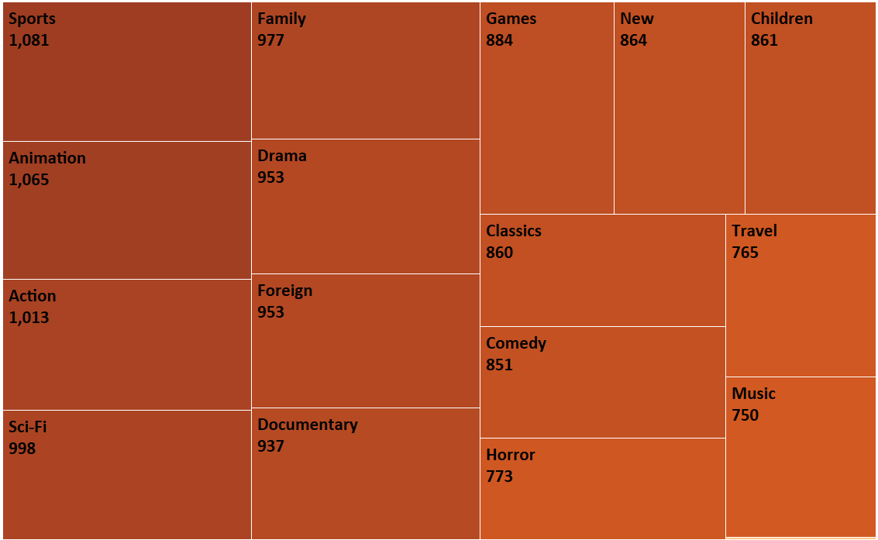
Global Movie Genre Popularity
Genre | % of Total
Sports | 8%
Sci-Fi | 7%
Animation | 7%
Drama | 7%
Comedy | 7%
New | 6%
Action | 6%
Foreign | 6%
Games | 6%
Family | 6%
Documentary | 6%
Horror | 6%
Classics | 5%
Children | 5%
Travel | 5%
Music | 5%
Thriller | 0%
Total | 100%
- 17 Different Movie Genres are popular throughout the world.
On a Global Basis, there aren’t any that dominate the movie viewing experience!
But on a Nationwide basis, there are definitely vast difference from one country to another……..

Slide 5

Spread of Regionalized Preferences Amongst Top 10 Countries
Top 5 Most Popular Genres for Each Country
Genre | In Top 5
Sports | 7
Drama | 7
Animation | 6
Foreign | 5
Sci-Fi | 4
New | 4
Action | 3
Comedy | 3
Documentary | 2
Children | 2
Family | 2
Games | 2
Classics | 1
Horror | 1
Music | 1
Travel | 0
Thriller | 0
Total | 50
Ranking | Country | One | Two | Three | Four | Five
1 | India | Sports | Foreign | Documentary | Children | Drama
2 | China | Animation | Sports | Family | New | Drama
3 | United States | Sports | Drama | Documentary | Comedy | Animation
4 | Japan | New | Drama | Animation | Sci-Fi | Sports
5 | Mexico | Sports | Sci-Fi | Foreign | Drama | Action
6 | Brazil | Sports | Animation | Sci-Fi | New | Horror
7 | Russian Federation | Sci-Fi | Family | Action | Classics | Games
8 | Philippines | Animation | Foreign | Sports | Games | Comedy
9 | Turkey | Drama | Animation | Children | Foreign | Comedy
10 | Indonesia | Action | Drama | New | Music | Foreign
Regionalized tastes in the Top 10 Markets indicate that preferences differ significantly from one country to another.
Sports, Drama & Animation are the only three Genres that achieve popularity in a significant number of Top 10 Countries.
Sports is number one in four countries but yet doesn’t even crack the top five in three others; indicative of the vast differences in nationalized viewing!

Slide 6

On both a Global and Regionalized basis, each Ratings Classification tends to amount to approximately 20% of the viewing market.
- Movie Ratings do not significantly impact and drive viewership.

Slide 7
Conclusion/Recommendations
Geographical Sales- Sales are not concentrated in specific geographical areas. Historical Sales data identifies the strongest markets spanning the globe into Asia, North America, South America & Europe.
Top 10 Countries - The 10 largest markets comprise 52% of Global Sales. It would be prudent to focus resources during the launch of the new streaming service in these robust markets.
Global Revenue Based on Genre- Global analysis of Movie Genre Rental Revenue identifies a very tight grouping where each of the 17 movie categories makes up approximately 6% each; not very enlightening.
Country Specific Revenue Based on Genre- A deeper dive into data for each individual country results in very insightful observations regarding genre and movie popularity! Genre popularity is vastly different from one country to another thus resulting in the ability to launch a unique and focused sales effort into each individual nation.

